Slide 1
2021 In Focus Topics
Strike Zone
Angles and Distance
Game Management

Slide 2
Strike Zone
The picture in our USA Softball Manual has not changed,
the RULE and the ZONE have not.
We want to be Accurate, NOT just Consistent.
The top/bottom of the strike zone is variable. WHY ?
Because it changes with each batter and possibly age group.
However the true zone ,
The top of the ball at the bottom of the batters sternum, to the top of the ball at the top of the batters knees.

Slide 3
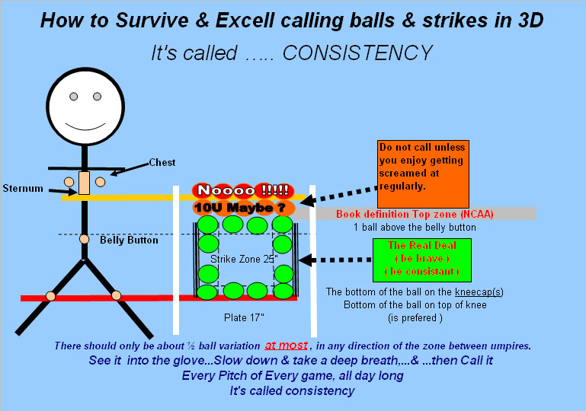

Slide 4
Strike Zone con’t.
The width of the Strike Zone is fixed. Why ?
It does not change with each batter.
The zone extends from the outer edge of the ball when the inner edge of the ball is over any part of home plate.
Home plate is 17”, the ball is 3.82”.
Therefore the true width of the plate is 24.64”.

Slide 5
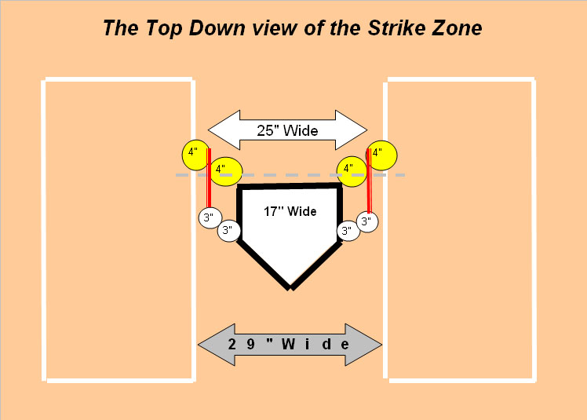

Slide 6
It all starts with your plate stance or position.
USA Softball
Approved Plate Stance:
Heel / Toe

Slide 7
Set Position
Umpire Must start in the Slot
The slot is defined as the position the umpire assumes prior to going set in which they are behind the catcher, slightly inside the inside corner of the plate with your ear closest to the catcher lined up with the inside corner and outside the perimeter of the strike zone.

Slide 8
Set Position cont.
You must have Good Pelvic Alignment (GPA)
This position is achieved when the umpire has their pelvis aligned with the outside front corner of the plate. This allows you to look down and through the strike zone.
Set no lower than the top of the strike zone in relationship to the batter.
Your body should be locked in a stationary position to see the ball released from the pitcher’s hand and travel all the way to the catcher’s glove or the ground. Your hands should be placed in a comfortable position in front of your body.

Slide 9
Set at the start of the pitch
In Fast Pitch this is when one hand is taken off the ball after the hands have been placed together. Each pitcher is different and the time you go set can vary accordingly.
Be sure to bend at the knees, not at the waist. This allows your back to be straight with a slight tilt forward to bring your head into the proper position. This will reduce the pressure on your lower back and the top of your legs
Being in the correct slot and set position on both sides of the plate gives you an unobstructed view of the strike zone on every pitch from the same angle.
.

Slide 10
Strike Zone
Calling the pitch is where the plate umpire puts the stance and set position to work
It is imperative that you are able to see the
entire strike zone
The top and bottom of the zone
The outside and inside corner of the plate

Slide 11
For additional information on Strike Zone & Plate Stance visit:
USA Softball Umpire Manual

